Slide 1
GOLDEN WAVE Produce better 27/02/2024

Slide 2
Audience Small, medium-sized, and large-scale farmers Groups or individuals producing or having biological wastes at their disposal Problems Seed wastage (use of at least twice as much of seeds as necessary) due to repetitive planting Reduced farm yields due to loss of soil fertility Reduce seed expenses by 50-65% The preservation of 12500 frs/ hectare for every reseeding The recovery of revenue shortfall of 50-75% (Observatory of family agricultural farms in Menoua)
Hint
If you have multiple audiences (ie sellers and buyers in a C2C platform) present both

Slide 3

Solution and Value Proposition Deploying a geospatial analysis and bio-fertiliser composer platform to users in the agricultural sector, including small, medium-sized, and large-scale farmers, requires careful consideration of their needs, technical capabilities, and access to technology. Determination of optimal planting date Calendar of plant water needs Fertilisation type and calendar Treatment calendar Specific technical assistance
Present your proposed solution to the problem.
Be concise and clear. Investors must be able to immediately see how your product will solve the problem you are trying to address.
Include images, visuals, diagrams, etc as appropriate.
Touch upon the scalability of your proposed solution (Investors want to invest in growth opportunities)

Slide 4
Product “Magic” - Allow users to customize the platform based on their preferences, workflows, and requirements. - Provide flexible options for data input, analysis parameters, and output formats to accommodate different farming practices, crops, and land characteristics. Geospatial analysis AI Mobile network Composting and bio fertilizers Guide to decision making based on the environment and bio-waste availability, Adaptable to every locality, as advise provided is tailored to the local characterisitics

Slide 5
Business Model Small, medium-sized, and large-scale farmers -By offering flexible pricing models that are affordable and accessible to farmers with varying financial capacities, including subscription-based, pay-per-use, or freemium options. - Provide discounts, subsidies, or bundled offerings for small-scale and medium-sized farmers to make the platform more economically viable. Sale of agricultural data -Advertisement of agricultural products -Extension of site services to soil analysis, e-marketing, and agricultural social media, and trainings
Explain your business model.
Who is your customer? How do you make money?
Include key issues like the intended pricing model, sources of revenue and associated costs
Mention opportunity for growth into new industries, territories, uses of the technology, etc

Slide 6
Market Analysis 47000 Family farms in menoua subdivision (researchgate.net) with a minimum of 60% being smartphone users. TAM : 2.75 million family farms in Cameroun (finmark.org.za) SAM : 1.65 million family farms in Cameroun SOM : 28200 family farms in Menoua
Outline the market size.
Present info related to Total Addressable Market (TAM), Serviceable Addressable Market (SAM) and Serviceable Obtainable Market (SOM).
Quantify the upside potential.

Slide 7
Competition Provide flexible options for data input, analysis parameters, and output formats to accommodate different farming practices, crops, and land characteristics. LOCAL (OUEST) : TAMI JARDIN, IRAD, AFROBIS AFRICA : AGRIBIS, E-AGRIBUSINESS, AGRI INVEST, GUINEAN HUB AGRI FOOD Use of patents
Show how you stack against the competition.
Communicate the competitive advantage you have over everybody else.
Mention intellectual property such as patents, copyrights, proprietary technology and trademarks.
Talk about why it will be difficult for a competitor to replicate your technology or product.

Slide 8
Go-to-Market Strategy Reliance on field experience and existing contacts for the dissemination of our gods and services Agro-pastoral shows and events. Farmer meetings with Divisional officers Inquiry from COOP-GIC to get into contact with producer organisations The tool being specifically designed based on observed on field difficulties will grease the pathway leading the appropriation of our tools by the farmers. Advertising field and online campaigns and word of mouth
Present your strategy for introducing your product or service to the market.
How are you going to acquire customers? What is the associated acquisition cost?
Mention your plans for penetrating an already competitive market.
Include distribution strategy, sales pipeline, etc.

Slide 9
Current Traction and Future Plans (Roadmap) 25 Families per month Communications via Yemba radio, Dschang campus radio, Social media we estimate full coverage of half Of our SOM in 3 years time
Present metrics related to current traction such as sales numbers, website traffic, downloads/registrations, growth rate, etc.
Include press, PR coverage, partnerships, success stories, etc.
Talk about your plans for the future (1-3 years) and how you will gain customers and revenue.
Demonstrate that your idea can be sent on a growth trajectory.

Slide 10




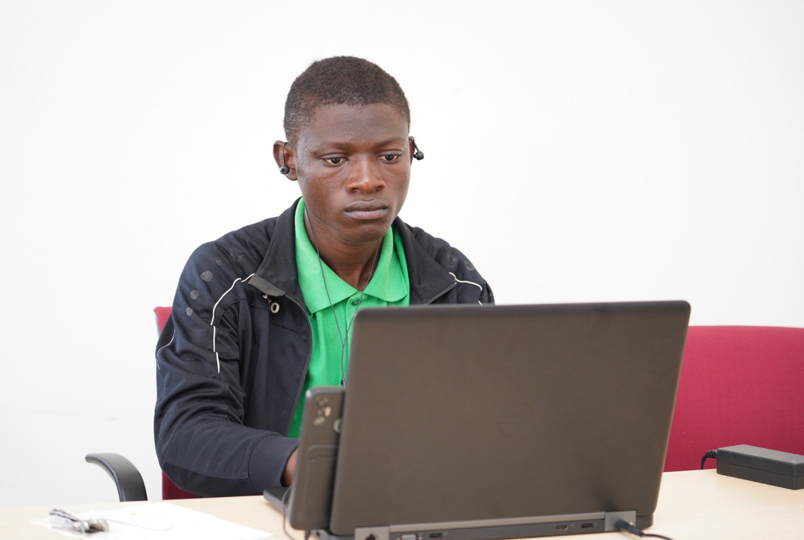
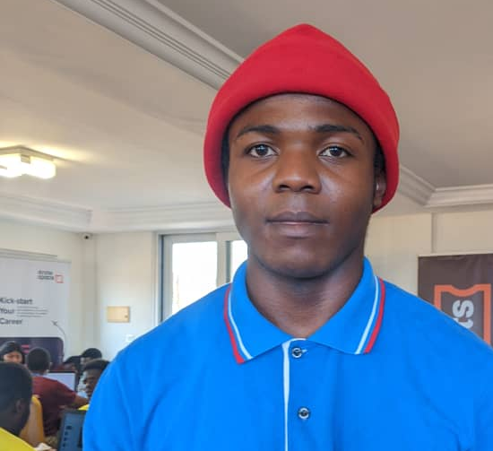
Team and Advisors
Present key team members.
Include names, pictures, what they do for your company.
What is their expertise, related experience, prior successes?
Demonstrate that you have a team that can execute on your idea and your company's potential.
MARTIN ELONGE
Business development expert
DEXTER NGR
JAVASCRIPT developer
MASSAHA NDONGMO GREENE
Agricultural engineer
Agropastoral Counselor
LEONEL DJOMATCHOUA
Graphic and Web designer
ML Programmer
ANDERSON METSANOU NANFACK
Backend engineer
MBOMDA EXPEDIT LEOPOLD
IT ANalyst

Slide 11
Cost Estimates and Projections Site hosting : 10000 frs per month Monthly running costs for advertisement 10 000 per month Monthly subscription per service 1000 Minimum Yearly estimated revenue 300000 (for the first year)

Slide 12
Capital Needed For a year Total 130000 frs Site hosting 10 000 frs Monthly advertisement 10000 frs EXPERTISE Market expertise
State how much capital you are raising, the terms (equity, convertible note, debt, etc), and how you plan to use it.
Include information on prior fundraising rounds and expectations you may have of your investors ie expertise, network, etc
Mention the milestones you can hit on a small budget in the short term, so that you de-risk the investment.

Slide 13

Together towards increasing agricultural productivity + 237 694970214

